Slide 1
Statutory Breeding and Technology Fee on Self-Pollinated Crops
AGBIZ GRAIN SYMPOSIUM
AUG 2019
Gert Heyns
CEO : SACTA

Slide 2
SACTA
MISSION
SACTA is the leading provider of management and administration for breeding and technology fees to support the development of new varieties and technologies in self-pollinating crops.
VISION
Ongoing access to improved genetics and technology for competitive crop production

Slide 3
Plant Breeders’ Rights and Grain Producers
Adequate legislation protecting the rights of plant breeders
Plant Breeders’ Rights Act (New Act approved – now regulations)
Plant Improvement Act
BUT
“Farmer’s Rights (Farmer’s Privilege)”
Producer may retain grain to plant a next crop, only on his own farm
Producer may not undertake any commercial activity with the saved grain, without a licence from the Plant Breeders’ Rights holder.
This leads to large volumes of grain retained for planting purposes.

Slide 4
Why a levy for Breeding and Technology needed?
Some of the most important grain crops are open of self pollinating crops:
Wheat (Farm saved seed 60% - 65%).
Barley ( FSS - Little).
Oats ( 80% +)
Soya beans (FSS 75% - 80%).
Canola (FSS – Relatively little. Use hybrid seed).
Groundnuts ( FSS – Very high).
Other crops – Lupins, rye, various grasses ……………..
Not an attractive market for investment for seed companies !
We are behind on new genetics and technologies
Notes:
Just some background regarding the current situation in RSA

Slide 5
COUNTRY | YIELD INCREASE p a 1998-2017
USA | 1,46%
BRAZIL | 1,33%
ARGENTINA | 0,64%
SOUTH AFRICA | 0,43%
Source : BFAP
Source: Grain SA

Slide 6
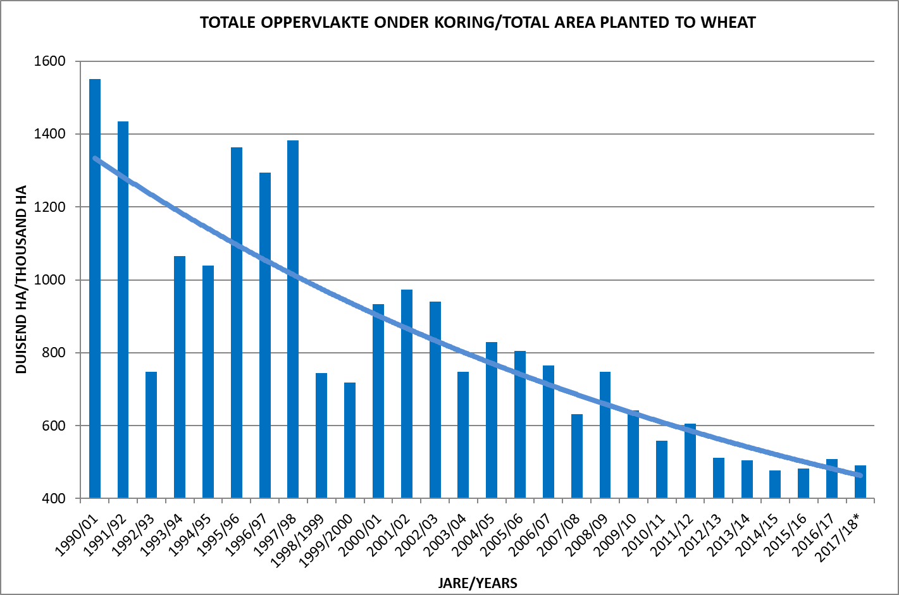
SA Production vs. Consumption (Wheat)
Source: SAGIS
Imported
Import 1,75 mil tons of wheat
Ha planted 508k

Slide 7
What collection systems do we find worldwide ?
Two types of systems are used:
ERS ( Extended Royalty System )
EPR ( Endpoint Royalty System )
B&TF ( Endpoint Breeding & Technology Fee )
Same principle
ERS - Argentina
- France
- Germany
EPR - Australia
B&TF - South Africa
Contracts and agreements
Declarations
Admin intensive
Efficiency 50% - 90%
An EPR is a system where a holder of Plant Breeders’ Rights exercises his right to a fee on the grain produced, rather than on the seed used or sold.

Slide 8
Which crops have a B&TF for PBR purposes
WHEAT AND BARLEY
Since 2016/17 season
Oats also has a levy since 2018/19
Levy currently is R30-00 per ton of grain
Payable at first point of sale by the producer
Payments made to companies OCT each year
Total value of payments made the first two seasons for wheat and barley ± R 60 mil

Slide 9
SOYA BEANS
Approval for a levy on soya beans – 22 July 2018
Two seasons : 1 March 2019 – 28 Feb. 2021
New technology should then be introduced, and a new application will then be submitted.
Current levy:
1 March - 29 Feb 2020 - R65-00 per ton
1 March - 28 Feb 2021 - R80-00 per ton
Payments to companies made in APRIL each year

Slide 10
Benefits of Statutory Levy as B&TF
A self-regulating system (95% efficiency for wheat & barley).
All grain of a specific crop is levied at first point of sale.
All producers pay the same levy.
Producers and Breeders share the risk:
Income directly linked to the level of variety performance
If farmer income is low due to drought etc., levies are also lower.

Slide 11
Why SACTA ?
SACTA is a NPC run according to the Companies Act (Act 71 of 2008).
SACTA dedicated to distribute levies only for breeding and technology purposes
SACTA supported by grain producers and it collects the technology fees from them.
SACTA is not crop specific, but administrates funds for all crops where needed
SACTA is aligned with role players who are knowledgeable regarding breeding and technology and the competitiveness of our producers.

Slide 12
How are funds applied ?
Because of a statutory levy – 20% for transformation
Administration & Commissions – 4,5%
Seed companies and other breeders – 75,5%
According to market share
Seed sales statistics
Farmer declarations
Silo analysis (wheat)
Market research
DNA analysis (new and still in developmental phase)

Slide 13
Which crops next ?
The B&TF system provides opportunity for other crop needs as well
Groundnuts
Lupins

Slide 14
What benefits have we seen so far ?
New wheat varieties from abroad are being tested.
Renewed investment into breeding programs
Renewed interest in soya beans
Expect new bio-technology in 2021
Trails will commence on about four additional bio-tech products
International companies relocating personnel to RSA business

Slide 15
WE NEED HELP !
All role players can influence and play a positive role.
Grain Silo Operators
Enforce seed company declaration at point of delivery. (all crops)
Samples to SAGL for quality (Can be used for DNA analysis)
Seed Industry
Seed reps make producers aware of declaring the variety planted
Use and involve SACTA where needed (training, farmer’s days etc)
Organised Agriculture
Promote the support of this system as far as possible. It is unique and will play a major role in food security in future.

Slide 16
Summary
RSA fortunate to have a practical unique system.
Renewed interest in the RSA wheat and soya bean seed market, locally and from abroad.
Three to four years from now, we could be on par with the rest of the world, with new bio-tech traits.
We need to support and contribute to these crops and system to ensure the longevity thereof.

Slide 17
THANK YOU
Website: www.sactalevy.co.za

