Slide 1

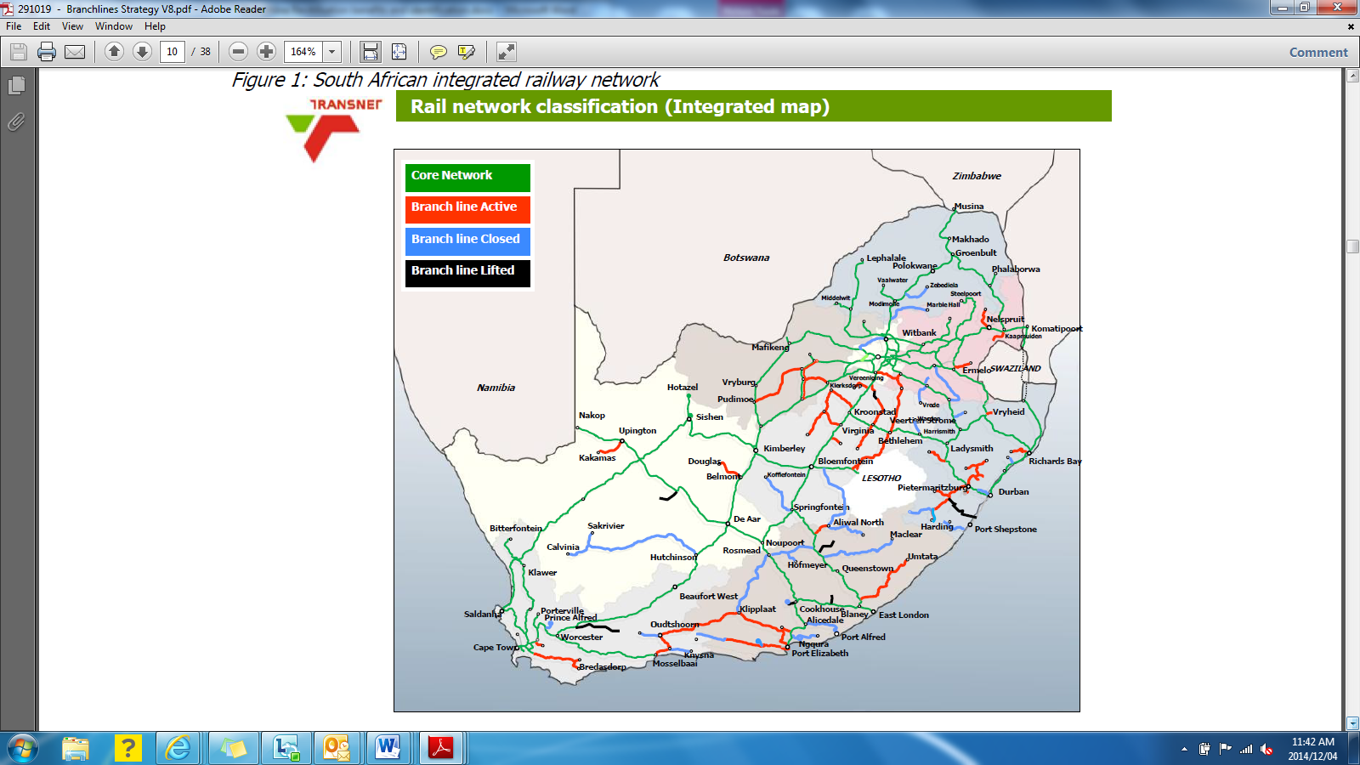
BRANCHLINE STRATEGY

Slide 2
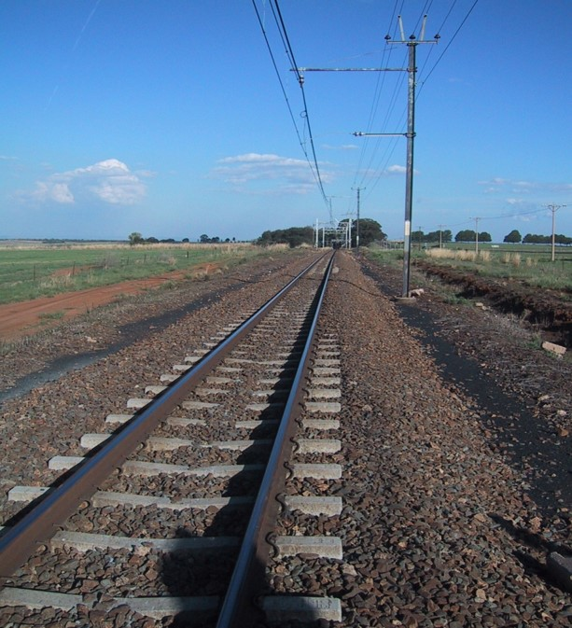
Presentation Outline
    Introduction
    Background
    Policy Statement
    General Railway Economic Regulation
    Strategic and Non – Strategic Branchlines
    Profile of South African Branchlines
    Branchlines – Filtering Matrix
    Branchlines Categorisation
PSP MODEL AND PILOT LINE SELECTION
Model Overview Finance
Model Overview Operating Costs
Economic Cost Benefit Analysis
Investment model results summary
Selection of Kroonstad as nominated pilot
WAYFOWARD

Slide 3
Introduction
  South Africa faces significant challenges of Rural Poverty and High Levels of Unemployment. Government has identified the transport sector as one of the significant drivers of the economy as it plays a critical role in enabling mobility and access to economic and social activities.
  South Africa has an extensive rail network of 30 400 km of track (20 953 route km)
      parts of this network have become under-utilised or closed over the last decade
      rail’s relative lack of competitiveness and market failures in commodities
      backlogs in rolling stock and infrastructure investment
  Branchlines are making up approximately 6 708 km of the rail network
      3350 km of branchlines closed and 874 of lines has been lifted
      relatively low volumes
      distinct train configurations (wagon loads)
      small scale operations (using diesel rather than electric traction)
      distinct infrastructure profiles (typically low axle load capacity) and multiple origin-destination points
      Almost all the branch lines feed cargo into the core network

Slide 4
Introduction Cont.…
Project Inter-Governmental Coordination - Established a Branchline Steering Committee:
  Department of Transport
  National Treasury
  Department of Trade and Industry
  Department of Public Enterprises
  Department of Agriculture, Forestry and Fisheries
  Department of Rural Development and Land Reform
  Department of Economic Development
  Passenger Rail Agency of South Africa
  Transnet
  PRASA
  South African Local Government Association

Slide 5
Background
Evolution of South Africa’s Branchline Strategy
2001
Cabinet approves the restructuring of Transnet Freight Rail
2002
Tripartite initiative categorises lines in term of high, light, and low density
2005
Cabinet approves the National Freight Logistics Strategy (NFLS) which anticipated the transfer of branch lines to a new rail utility
Transnet Board approves the transfer of branch lines to the National Department of Transport (similar to the way Metrorail was transferred to PRASA)
Transfer did not occur because the Department did not have the required institutional arrangements
2007
Transnet submit a revised branch line strategy to DPE and obtain approval to ring fence branch lines within Transnet and to concession them to the private operators
The idea was to still transfer these lines to a separate public entity when such an entity was established
2008
The DOT Branch line Strategy recommends the revitalisation of branchlines under the concessioning plan proposed by the Transnet, in the absence of a rail economic regulator or a separate public entity
Concessioning was due to start in early 2010 and conclude in 2014
2009
2014
DOT Initiates the revision of its 2009 branch line strategy
2015
Green Paper on Rail Policy developed that gives policy direction
2019
Draft White Paper on Rail Policy developed to be adopted by Cabinet
Notes:
In 2001, Cabinet approved a restructuring model for Transnet Freight Rail (TFR) (then Spoornet) that included the requirement for revitalisation of the Branch Line Network (BLN) and a management model be developed under Transnet.
In 2002, a tri-partite initiative, including Government, Organised Labour, and Transnet Freight Rail formed a Technical Working Group, which agreed on the classification of the network, namely: high, light and low density, as well as the establishment of LINKRAIL within TFR to manage the identified and classified lines.
In 2005, Cabinet approved the National Freight Logistics Strategy (NFLS) which anticipated the transfer of branch lines to a new infrastructure utility.
In August 2007 Transnet Board approved the transfer of branch lines to DOT.
In September 2007 DOT informed Transnet that it lacks institutional arrangements to take over branch lines.
In 2008 Transnet Board approved the revised branch lines strategy, following which the Minister of Public Entities approved the strategy, in alignment with the PFMA.
In 2009, The DOT, DPE and Transnet produced a draft Branch line Strategy, which aimed at introducing private sector participation into branch line operations.

Slide 6
Policy Statement
Freight rail market and organisation structure
Regulated on-rail competition shall be introduced on the national network by admission of qualified third party freight train operators
Transnet Freight Rail (TFR) will be split into two divisions namely: Transnet Rail Infrastructure and Transnet Rail Operations.
  Transnet Rail Infrastructure will be responsible for amongst other things Infrastructure maintenance, network safety and security, train control and investment in the rail infrastructure guided by railway inherent competitiveness fundamentals.
  Transnet Rail Operations will be responsible for amongst other things, haulage on network mainline and branchlines, yard operations, train safety, locomotive ownership and leasing.
Separation of TFR Infrastructure Manager and TFR Train Operator
will enable the Transport Economic Regulator (TER) to make informed rulings as required

Slide 7
Policy Statement
Freight rail market and organisation structure cont…
Regulated on-rail competition shall be introduced on the national network by admission of qualified third party freight train operators
Transnet Freight Rail (TFR) will be split into two divisions namely: Transnet Rail Infrastructure and Transnet Rail Operations.
  Transnet Rail Infrastructure will be responsible for amongst other things Infrastructure maintenance, network safety and security, train control and investment in the rail infrastructure guided by railway inherent competitiveness fundamentals.
  Transnet Rail Operations will be responsible for amongst other things, haulage on network mainline and branchlines, yard operations, train safety, locomotive ownership and leasing.
Separation of TFR Infrastructure Manager and TFR Train Operator
will enable the Transport Economic Regulator (TER) to make informed rulings as required

Slide 8
General railway economic regulation
Ensuring non-discriminatory or fair access to essential rail infrastructure and facilities, as well as fair pricing and associated terms and conditions, to train operations in relation to access quality and standards;
Regulating market entry and exit, revenue adequacy, service quality levels, tariff approval and commercial dispute resolution.
Regulating the provision of adequate, affordable, efficient and sustainable rail services;
Promoting and regulating on-rail competition in a way that all participants perceive the playing field to be level;

Slide 9
General railway economic regulation cont…
Promoting equity of access to new entrants for investment in rail equipment, infrastructure and services;
Overseeing commercial agreements among train operators;
Determining a fair and reasonable basis for setting access tariffs for using essential rail infrastructure and facilities, to inform assessment of tariff approval requests received from infrastructure owners and train operators;
Investigating complaints and conduct market enquiries where necessary or where requested by competent authority;
Determining and administering penalties for non-compliance with access terms and conditions

Slide 10
Strategic and Non – strategic Branchlines
The draft White Paper on National Rail Policy calls for Branchlines to be categorised into Strategic and Non - Strategic based on their wider socio-economic impact:
Strategic branch lines are those that have the potential to have a large social-economic and developmental value due to factors such as:
Their potential to stimulate rural economic development;
The volumes/mass to be transported along the line (actual and/or potential);
Their ability to reduce the damage to roads caused by road freight traffic that could be transported by rail.
Strategic Branchlines can be viewed from two perspectives:
1. Socially strategic (economically viable) with the potential to be financially viable; (B)
  Branch lines that could uplift the socio-economic conditions (economically viable) in the areas adjacent to the branch lines and are also likely to be attractive to private investors.
  2. Socially strategic (economically viable) however not likely to be financially viable; (C)
  Branch lines that could uplift the socio-economic conditions (economically viable) in the areas adjacent to the branch lines, however are not financially viable.

Slide 11
Strategic and Non-Strategic Branchlines Cont.….
Non-Strategic branch lines are those that are not expected to have a large social-economic or development impact in surrounding areas:
Limited potential to stimulate rural economic development.
Could still have a positive environmental impact and could be financially viable
Non-Strategic Branchlines can be viewed from two perspectives:
1. Financially viable (A)
  Branch lines that are likely to be attractive to private investors and are located in areas with low socio-economic indicators.
2. Not Financially or Economically viable (but can be kept for future consideration) (D)
  Branch lines that are unlikely to generate sufficient revenues to cover costs, and are located in areas with low socio-economic indicators.

Slide 12
Strategic and Non-Strategic Branchlines Cont.…
A Potentially Financially Viable | B Socially Strategic + Potentially Financially Viable
D Future Consideration | C Socially strategic + Financially not viable
HIGH
Revitalisation strategy should be based on a commercially driven business case, limited for state subsidies. Consideration maybe given to offering once off state incentives to improve attractiveness of projects
Revitalisation strategy should also be based on a commercial business case, but a strong case for state involvement should be made based on the possible
social-development impact
Potential competitiveness of line
Alternative criteria maybe applied to motivate against closure of the line, else lines should be closed
Revitalisation strategy should be based on a socially driven business case which provides a motivation for state subsidies based on the social benefits that will be derived.
LOW
LOW
Social Economic Indicators
HIGH

Slide 13
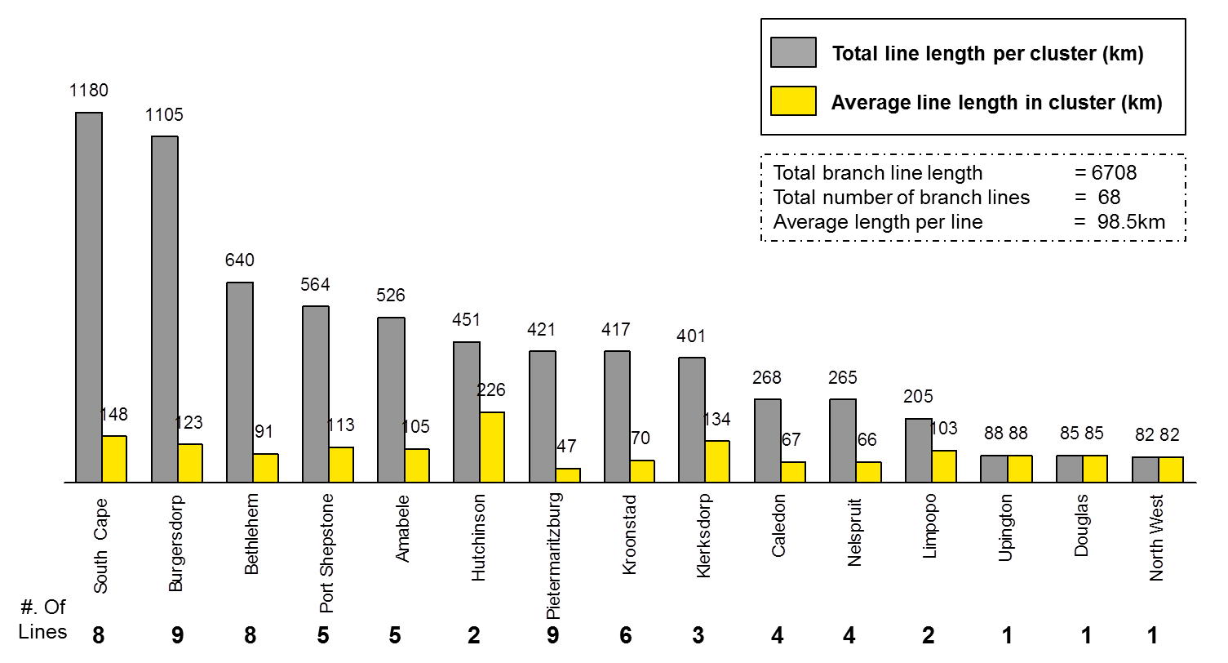
Profile of South African Branchlines
  Profile Branchline network – Cluster perspective

Slide 14
Profile of South African Branchlines Cont.…
Province | Number of branch lines | Total line length | Related branch line clusters
EC | 17 | 2305 | Amabele, Burgersdorp, South Cape
FS | 16 | 1456 | Bethlehem, Kroonstad
KZN | 14 | 985 | Pietermaritzburg, Port Shepstone
WC | 6 | 370 | Douglas, Caledon, South Cape
MP | 5 | 270 | Nelspruit
NC | 4 | 624 | Douglas, Hutchinson, Upington
NW | 3 | 401 | Klerskdorp
Limpopo | 2 | 205 | Limpopo
Gauteng | 1 | 82 | North West
Total | 68 | 6708
      80% of branch lines, by number, and 75% by length, are located in the Eastern Cape, Free State, KZN and Western Cape
      83 municipalities are serviced by branch lines, unemployment in 50 municipalities is significantly higher than the national average and economic growth in 25 municipalities is lower than the average

Slide 15

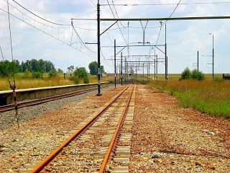
Branchlines - Filtering Matrix
Proposed approach to selecting the pilot branch line or cluster of branch lines
1st pass analysis:
      Shortlisting of branch lines /clusters based on their potential to unlock the economic potential of the areas there are in or traverse
2nd pass analysis:
      Evaluation and ranking of shortlisted branch lines and clusters
PILOT
      KROONSTAD CLUSTER
Universe of branch lines
Branch line / Cluster 1
2
3
4
5
BL / C₁
BL / C₂
BL / C₅
Socio - economic considerations
Line operability
Customer attractiveness
Impact on modal shift
Investor / beneficiary interest
BL / C₃
BL / C_{n-5}
Readiness of stakeholders
BL / C_{n-1}
BL / C_{n-1}
BL / C_{n}
Investment Model
    Commercial and economic assessment comparator
    5 branchlines populated, analysed and discussed at technical committee meetings
Final selection
    Steering Committee
Assessment to based on:
    Identification of branch lines or clusters located in areas whose socio- economic development potential is currently unrealised and/or declining due to poor transport links in and out of the area
Assessment to based on:
    A review of the economic activities /actors present in the areas where the branch lines are located .
    Review of freight flows on branchlines and on road network in the region
    Review of information available about the quality of the branch lines and their state in terms of usability

Slide 16
Model overview
Finance
Capex
Freight/ demand
Finance costs
Cost of capital
Net profits before taxes
Revenue (pricing and
distance)
Operating costs
Passenger
Adjustment
        Revenue and cost allocation

Slide 17
Model overview
Operating costs
Freight/Demand
Wagons & Trains needed
Operating costs
Employee costs (trains –
Servicing)
Maintenance (locos & track)

Slide 18
Model overview
Economic Cost benefit analysis (CBA)
Benefits
Internal benefits
External benefits
Opportunity cost of funding
Economic Net Present Value
Benefit to Cost
Costs
Internal costs
External costs
Road subsidies

Slide 19
Investment Model Results Summary
Comparison of the five lines
Commercial indicators focus on the profitability from the branch line, which include:
An assessment of the NPV and IRR over the 20 year horizon (in real terms, before tax);
Operational profitability;
Time to profitability during the 20 year investment horizon;
Subsidy requirement;
    The need for an on-going operating subsidy, or a subsidy targeting initial investment in the branch line; and
The impact of changes in key variables, such as demand and labour costs;

Slide 20
Investment Model Results Summary
Comparison of the five lines Cont.…
Economic indicators focus on the impact of each branch line on society through the use of a CBA, which include:
Economic net present value;
The benefit to cost ratio;
The impact of externalities (carbon emissions, etc.);
Direct and indirect job creation surrounding each line;
Branch line/cluster | Benefit: Cost ratio | ENPV benefits | Total benefits | Total costs
Kroonstad | 1.68 | R 368 m | R 2 460 m | R 1 338 m
Mthatha-Amabele | 1.52 | R481 m | R 3 065 m | R 2 154 m
Sterkstroom-Maclear | 1.18 | R 174 | R 2 896 m | R 2 273 m
Empangeni-Nkwalini | 1.14 | R 48 m | R 1033 m | R 868 m
Nelspruit | 1.27 | R118 m | R1 461 m | R 1078 m

Slide 21
Selection of Kroonstad as nominated pilot line
Based on these outcomes, from the commercial, economic and implementation point of view, the Kroonstad cluster is recommended as the pilot for implementation. This is due to the fact that the cluster:
Does not require a subsidy in order to proceed to implementation;
The cluster requires a low level of investment and has a stable set of demand from key anchor tenants;
The highest benefit to cost ratio and a positive Net Present Value;
Has a high probability of success due to strong levels of demand currently;
Does not require a big shift in policy to assist with implementation, but can also benefit from an increase in the level of support either through a focussed agricultural strategy in the region, or through a subsidy taking the current levels of funding aimed at the road transport sector already;
The successful implementation of the Kroonstad cluster can also start to build on the momentum for the full development of a programmatic approach to the revitalisation of branch lines in South Africa.

Slide 22
Wayfoward
Implementation of the pilot Branchline

Slide 23
THANK YOU
Death of Graaff-Reinet rail traffic

