Slide 1

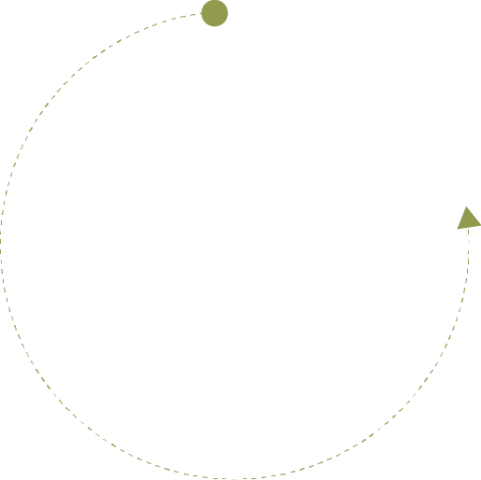






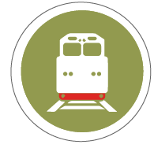


Transnet Online
Track and Trace

Slide 2


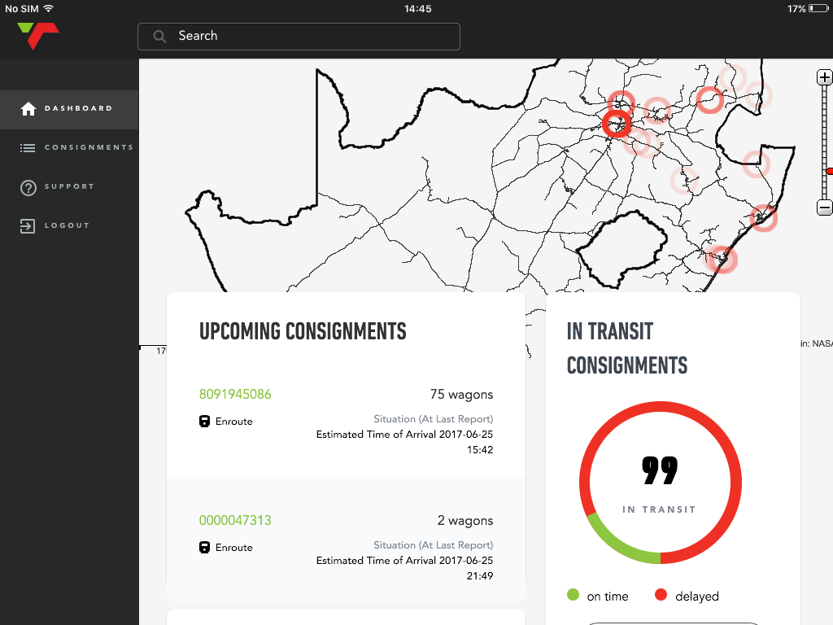

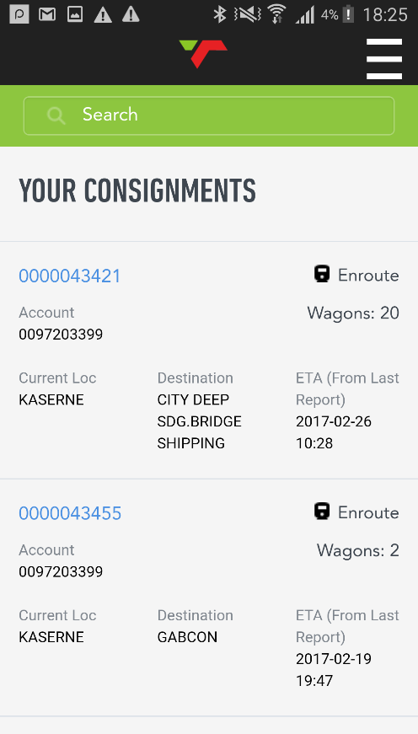
Transnet Online: Track and Trace
Allows Transnet Customers to Track
all their consignments across the whole
Value-chain
in Real Time
Transnet
Online

Slide 3
Benefits To Our Customers
Search and Track consignments from the palm of your hand
Proactive
Monitoring and Planning
Real-Time
performance management
Improved communication
on your
Consignment Whereabouts
Transnet
Online

Slide 4
Future Capabilities
Online Wagon Release
Customer facing functionality that allows for seamless wagon releases
Transnet
Online
Empty Wagon Placements
Information published of
empty wagon placements
Customer Service Catalogue
Transparency for customers
for train schedules
Integrating all functionality into
a single platform
Invoicing, Statements and interest letters amongst many others

Slide 5

How do I get access and support
There are 2 ways to register for Transnet Online
1. Download the App from your app store (Android and IOS)
  Open The App
  Select Register just below the login button
2. Visit www.transnetfreightrail.co.za
  Select Business with Us
  Select Rail Online Registration
  Complete the registration form online.
  Once your application has been confirmed by our credit department you will receive your login details via e-mail and you will be able to login.
Support
1. Call our Customer interaction
Center on:
+27 (0)860 690 730
2. Send an e-mail to: TFR911@transnet.net
3. Get In Touch with your
Transnet Key Accounts
Manager

Slide 6
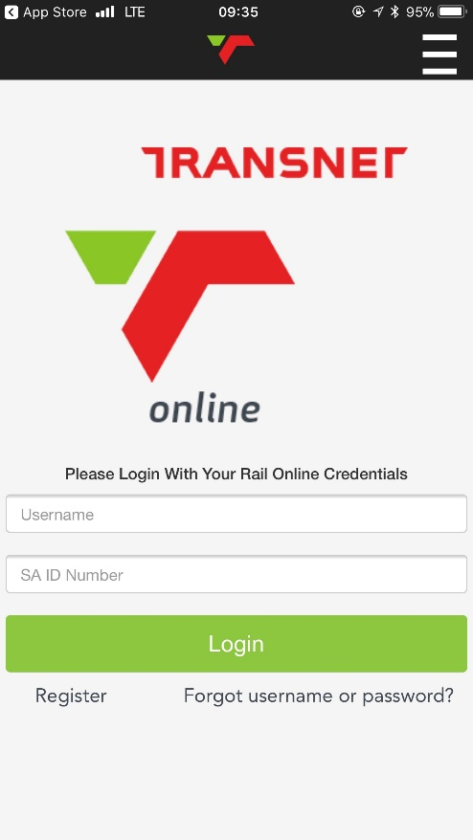
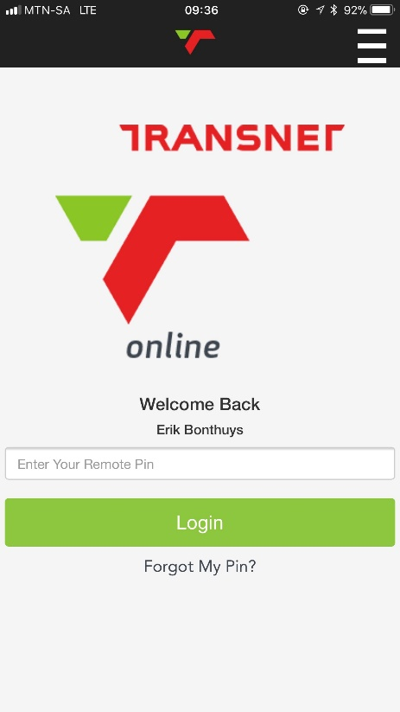


Login
User Login:
A user will be requested for there Username and SA ID number on initial login.
Customers can set a 5 digit pin for easy login on all subsequent logins

Slide 7
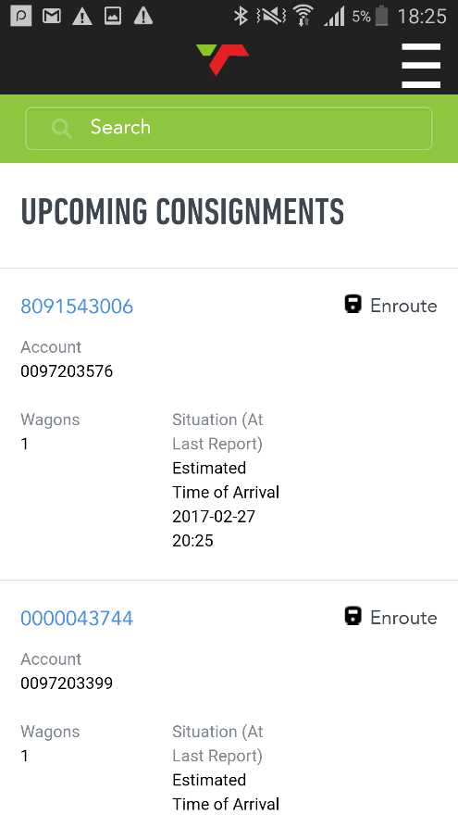
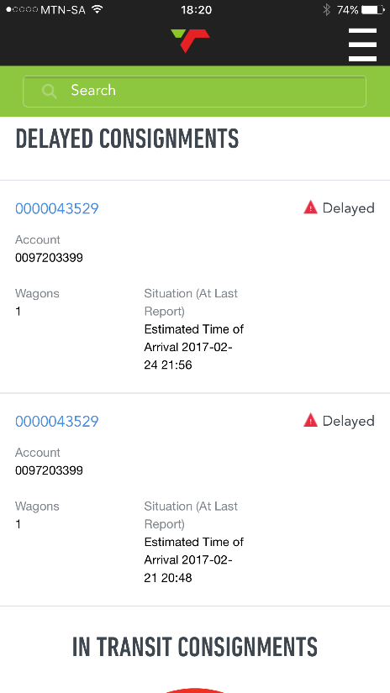
Dashboard
Upcoming and Delayed Consignments:
Upcoming: 2 consignments closest to arriving at it’s destination.
Delayed: 2 consignments that is delayed for the longest period of time.
A recalculated ETA at it’s last reported location is also shown

Slide 8
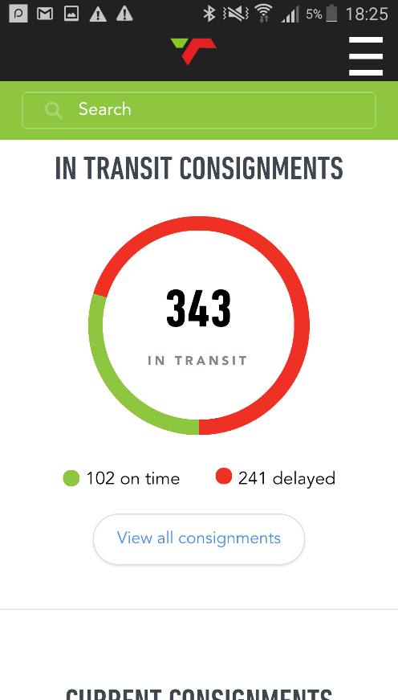
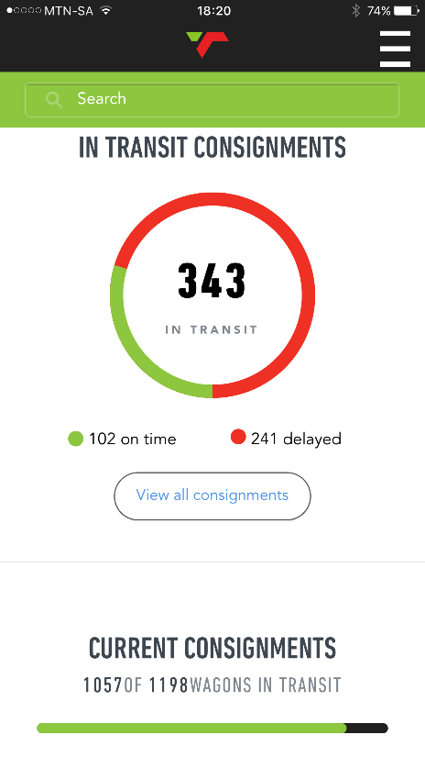
Dashboard
In Transit Consignments:
The doughnut chart shows how many consignments are in transit. On time versus delayed
Current Consignments:
The progress bar shows how many of the total wagons for all consignments linked to the current user are in transit

Slide 9
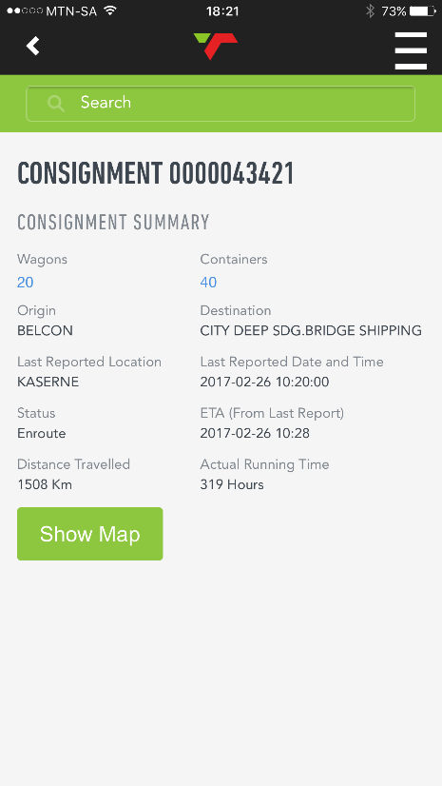
Consignment Details
Your Consignments:
Shows a list of all consignments linked to the user or a filtered list depending on the search criteria entered
The consignment number is also clickable to navigate to the consignment details
Consignment Summary:
Shows all details for a consignment. This information is retrieved from the same data source as the desktop version of consignment Tracking

Slide 10

How Do We Track Your Consignment
Tracking Capability
SPRINT
Wagon Movements
IATS
Wayside readers
CS90
Train Signaling System
Triton
Train GPS Positioning
Operational Systems
Service Management
CXMM
Navis

Slide 11
Search Bar
Search Bar:
The user will be able to use the search bar from any screen on the application.
Searches can be preformed on 7 criteria to return results.
Account Number
Wagon Number
Container Number
Consignment Number
Train Number
Service Code
NWB Reference Number
VIN Number (Import)
When search is completed a screen on the right will be displayed

Slide 12
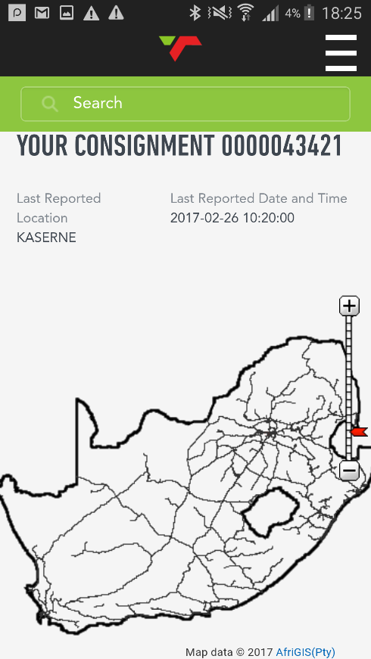
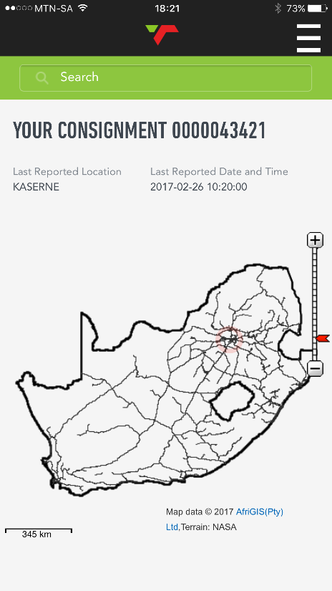
Your Consignment On A Map
Map Screen:
Shows the last position of the consignment on the rail network

