Slide 1



SHAPING A WORLD
OF TRUST
SHAPING A WORLD
OF TRUST
A Global leader in testing,
inspection & certification SERVICES
A Global leader in testing,
inspection & certification SERVICES
Speaker : Callie Kruger
Title: Agri Manager SAC
Agbiz Grain Symposium 14 August 2019

Slide 2









PORTFOLIO OF BUSINESSES
Certification | Certification of QHSE management systems and second party auditing services
Commodities | Commodities inspection and testing: oil & petrochemicals, metals & minerals, agriculture
Construction | Conformity assessment of buildings and infrastructures
Consumer Products | Testing, inspection and certification of consumer goods
Government Services & International Trade | Trade facilitation services
Industry | Risk management, quality assurance, quality control and asset integrity management of facilities and equipment
In-Service Inspection & Verification | Periodic inspection of equipment & facilities in operation
Marine & Offshore | Classification and certification of ships and offshore units

Slide 3


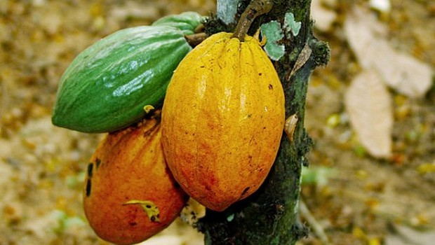
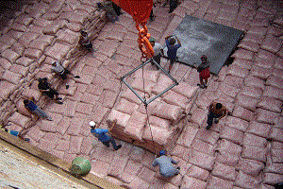
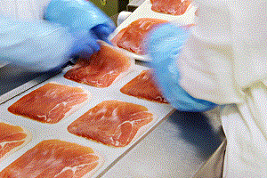

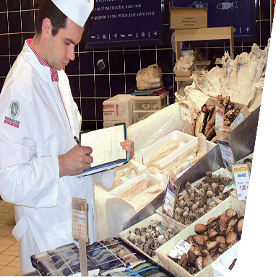

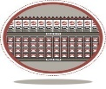


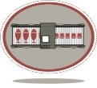

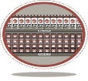


Summary of Agri-Food Segments
Upstream (Agri Services)
Downstream (Food)
Digital platforms
Drone data capturing
Satellite data support
Digital Grain Grading Equipment
Chemical & Residue Testing
GMO Testing
Microbiology Testing
Water/Soil Analysis
Global GAP cerification
Commodities Inspection
Quality and Quantity Testing
Verification of Conformity
Loading & Unloading
Inspection
Stock Monitoring
Sampling and testing of grains
GMP
Food Manufacturing System Certification
Microbiology and Pathogen Services
Chemical and Residue Testing
Process monitoring for processing plants
Product Integrity
Nutritional Labelling
Product Certification
Supply Chain Management
Food Manufacturing Certification Schemes(GFSI. environmental, social...)
Customized Supplier Audit/Risk Monitoring Programs
Digital Food Safety Monitoring
Food Product Testing
Store Certification
Retail Risk-based Inspection
Customized Audits and Inspection Programs
Brand Best Practice Compliance
Digital Food Safety Monitoring
Sample Testing in Stores
Mystery Shopping
Hotel and Restaurant Certification
              Hospitality
              Precision Farming
              Production
              Trading
              Processing
              Brands
              Retail

Slide 4



Slide 5




We use computer vision and artificial intelligence to improve performances in the Agro market.

Slide 6
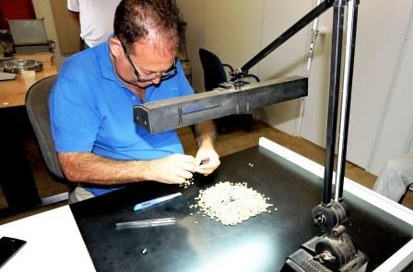
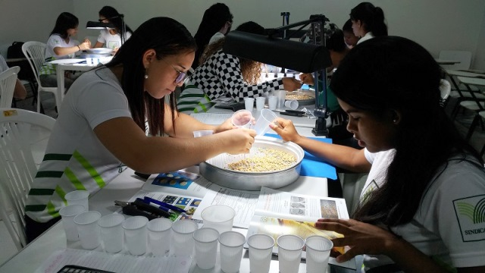
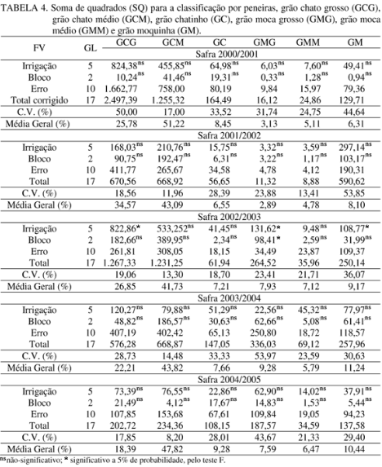
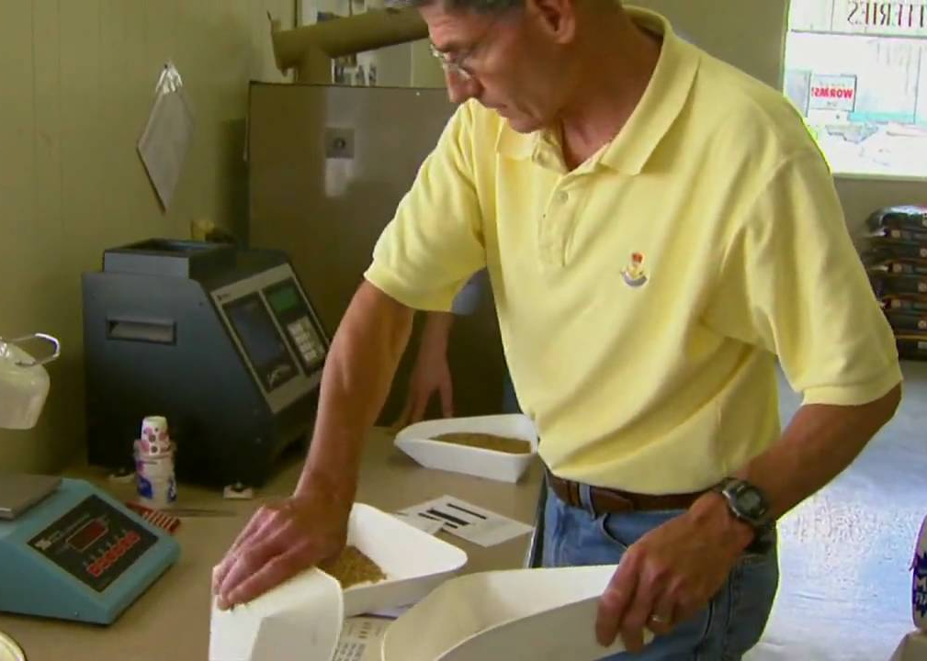
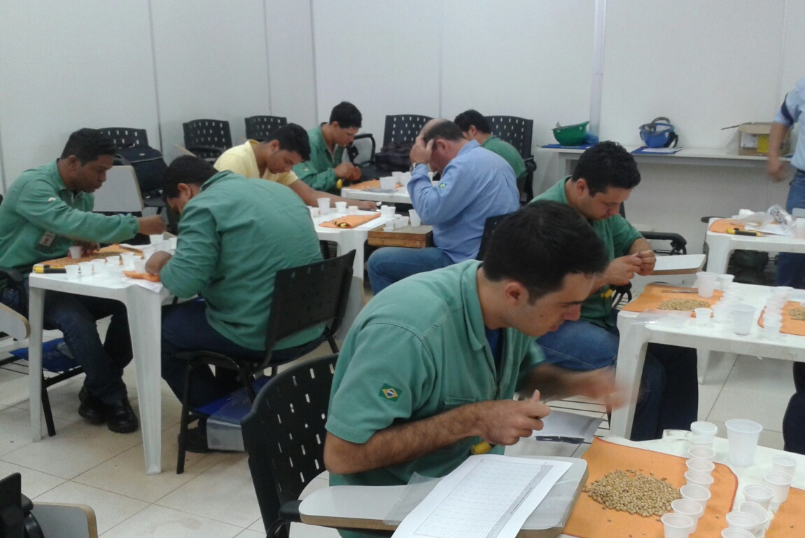
Certification and Classification:
today´s practises

Slide 7






Problem we solve
The quality analyzes of agricultural goods are done manually by visual inspection
How the analyzes are done today:
Samples
Manual or chemical analysis
Human
interpretation
Manual reports
Traditional archive
Lack of standardization (human subjectivity)
High Cost
High necessity of hand labor
Elevated time

Slide 8





1
Tbit’s solution
2
Capture module
Image captured
Classification
Reports
Data
storage
3
4
5

Slide 9
WE OPTIMIZE
WE DECREASE
WE DECREASE
WE DECREASE
up to
up to
up to
up to
80%
of the grain grading
70%
of the release time
of seed lots
50%
Of the hand-labor needed
20%
of the processed and returned lots
Gains
Eliminates human errors;
Transparency in trade negotiations;
Traceability (visual counterproof);
Allows visual counter-tests;
Real-time tracking on various sites.
Standardized analyzes;
Reduction of costs;

Slide 10





























Clients
and Partners

Slide 11
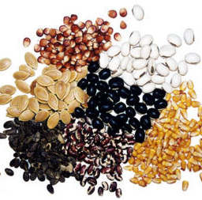

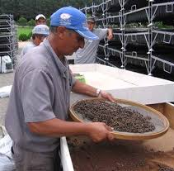
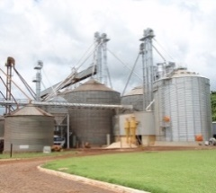
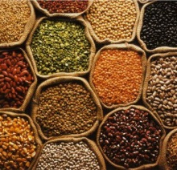

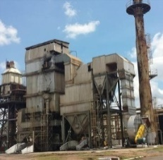
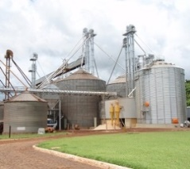
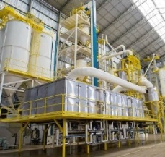
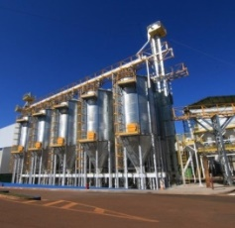

Breeders
Multipliers / Distributors
Processing units
Cooperatives
and warehouses
Seeds
Traders
TIC Companies
Processing industry
Cooperatives
and warehouses
Current Market
Grains
PET feed industries
Big animals feed industries
Feed
Fertilizer Industries
TIC Companies
Fertilizers

Slide 12
Soy
Rice
Tobacco
Fruits and vegetables
Cultures / products that TBIT works
Corn
Leaves
Sugar
Barley
Wheat
Peanut
Cocoa
Feed
Beans
Seedlings
Hay
Sugar cane

Slide 13
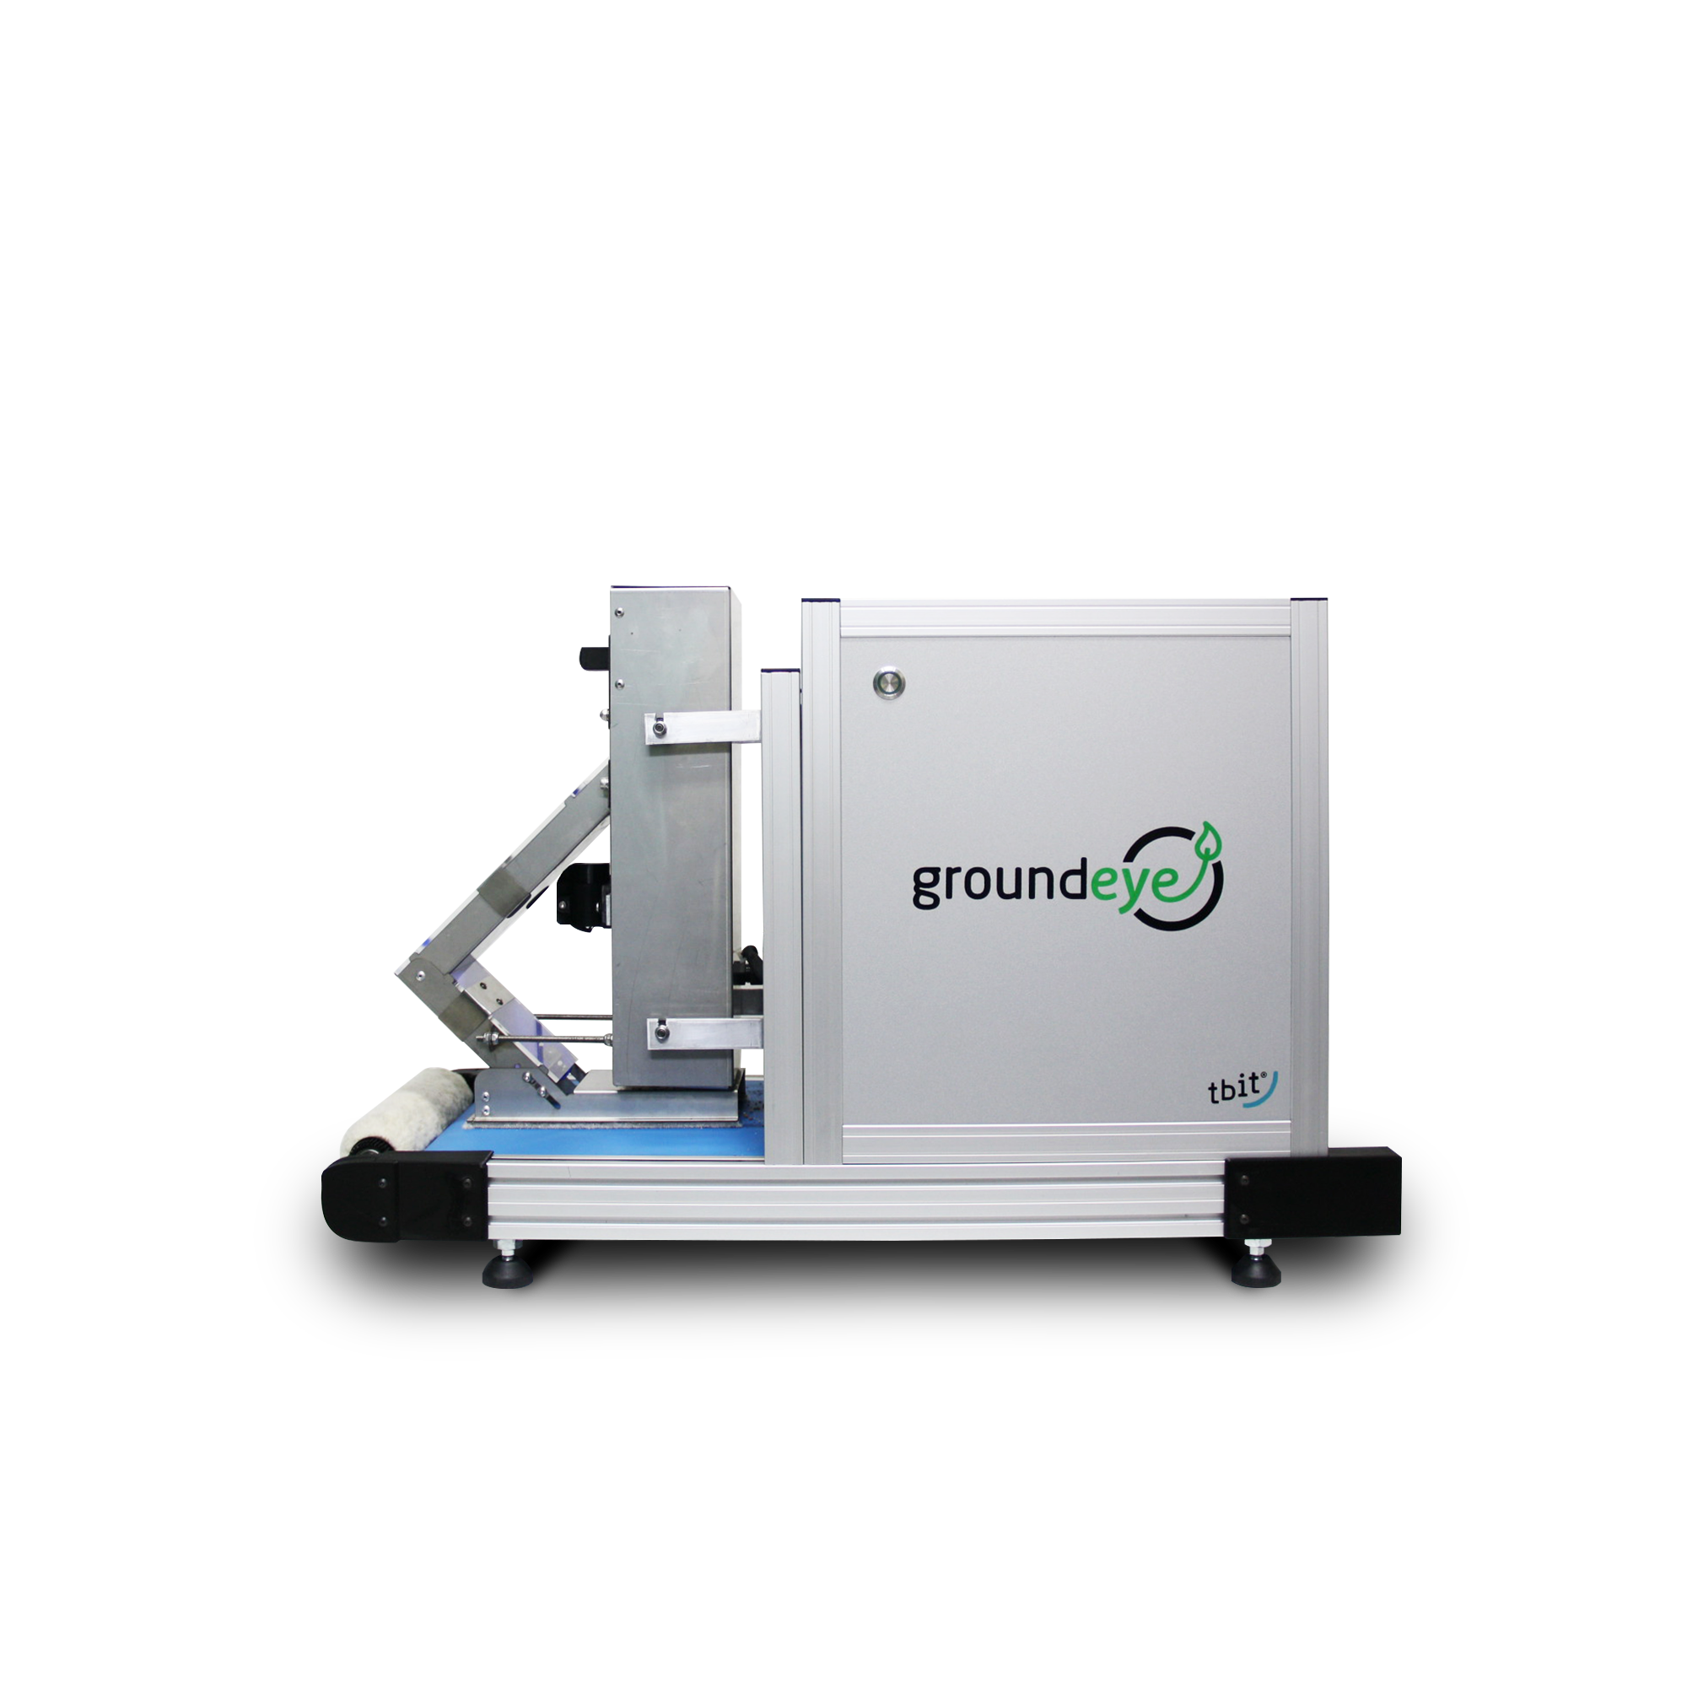




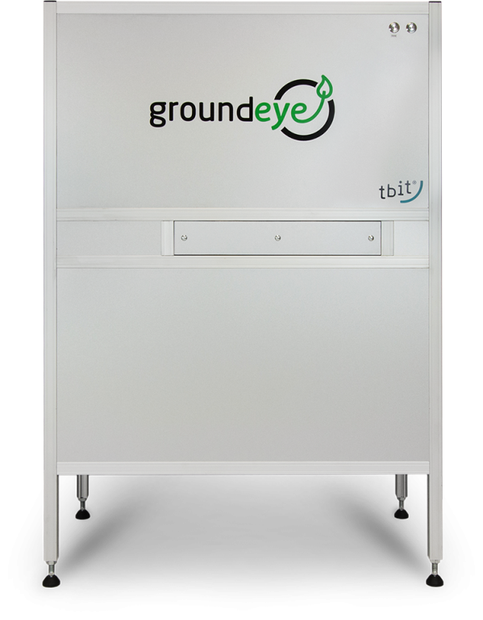

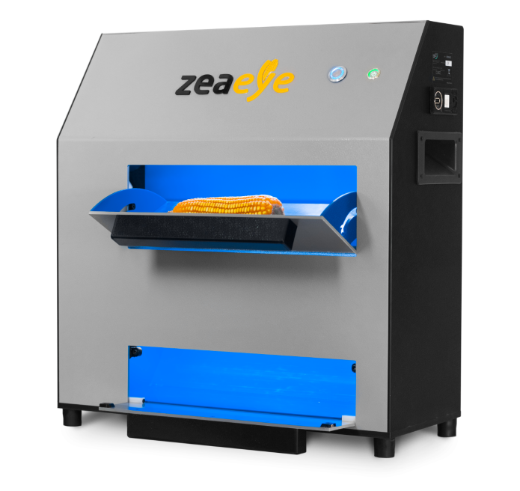
Main products
Seed treatment
Seed treatment coverage quality;
Grains
Soy and corn grading;
Eliminates human subjectivity;
Enables traceability of results, real-time monitoring of quality and big data;
Top and bottom image;
Feed:
Count and weight of one thousand elements;
Uniformity of products;
Contaminants;
Product mix;
Physical defects;
Classification of pellets
Corn ear;
Index of granulation, number of grains and the measurements of the corn cobs;
Portable equipment;
4 images per corn ear;
IOT / Cloud based system;

Slide 14
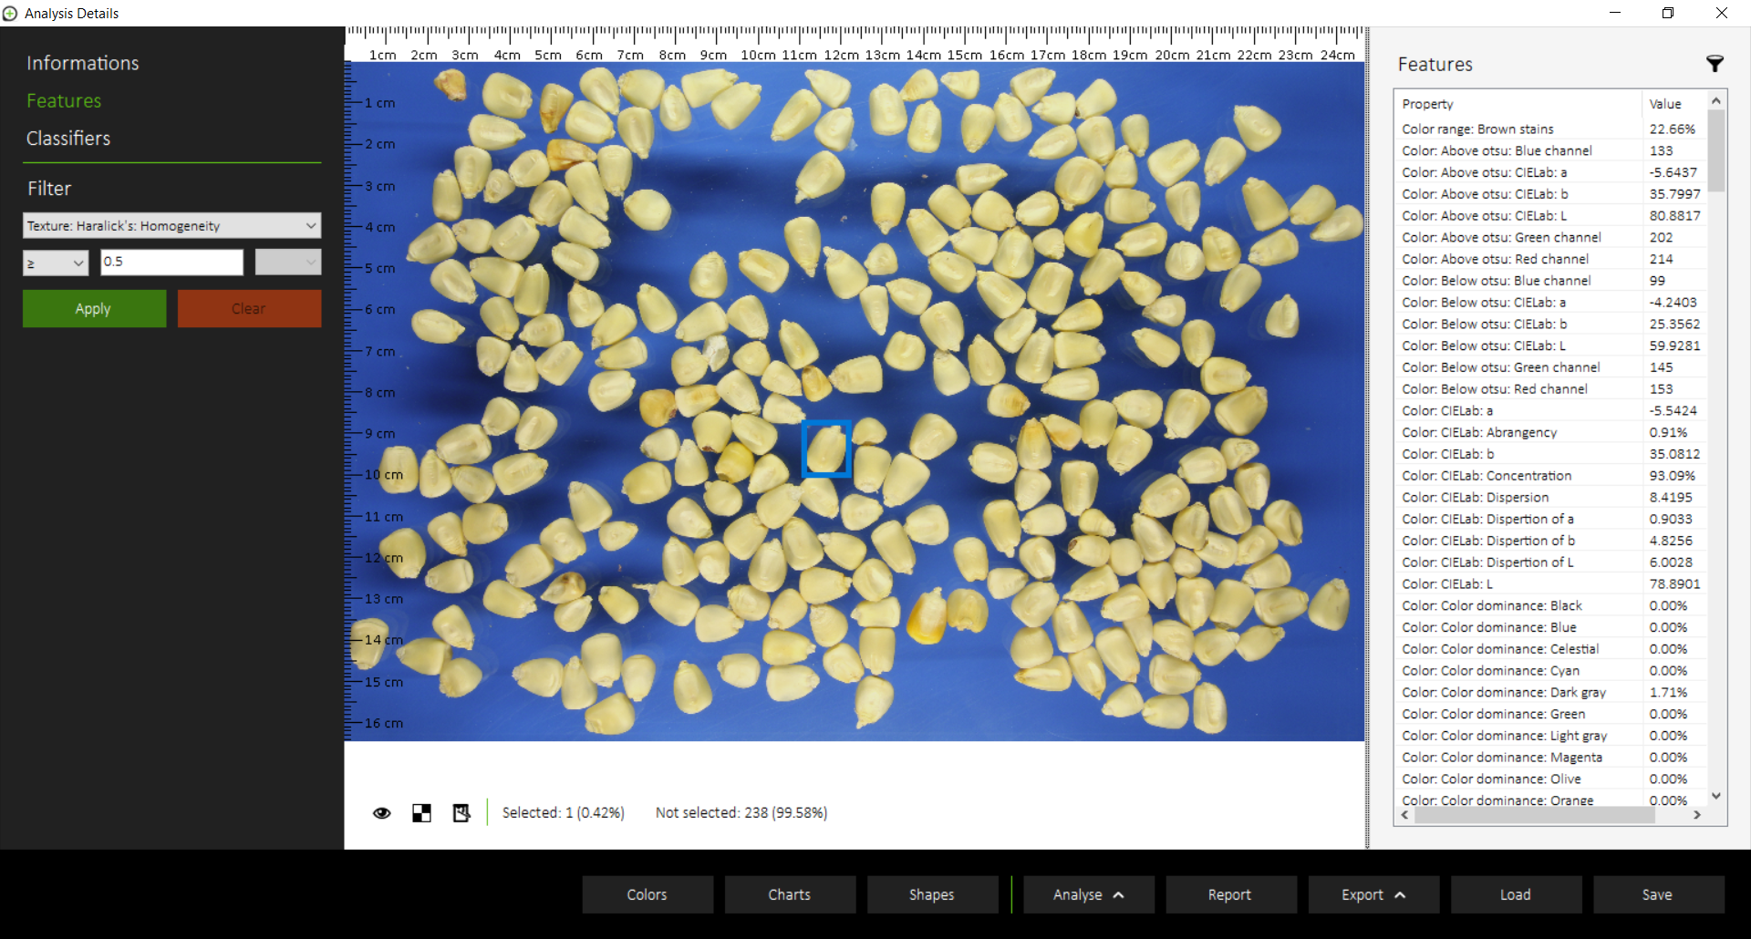
White maize – original image

Slide 15
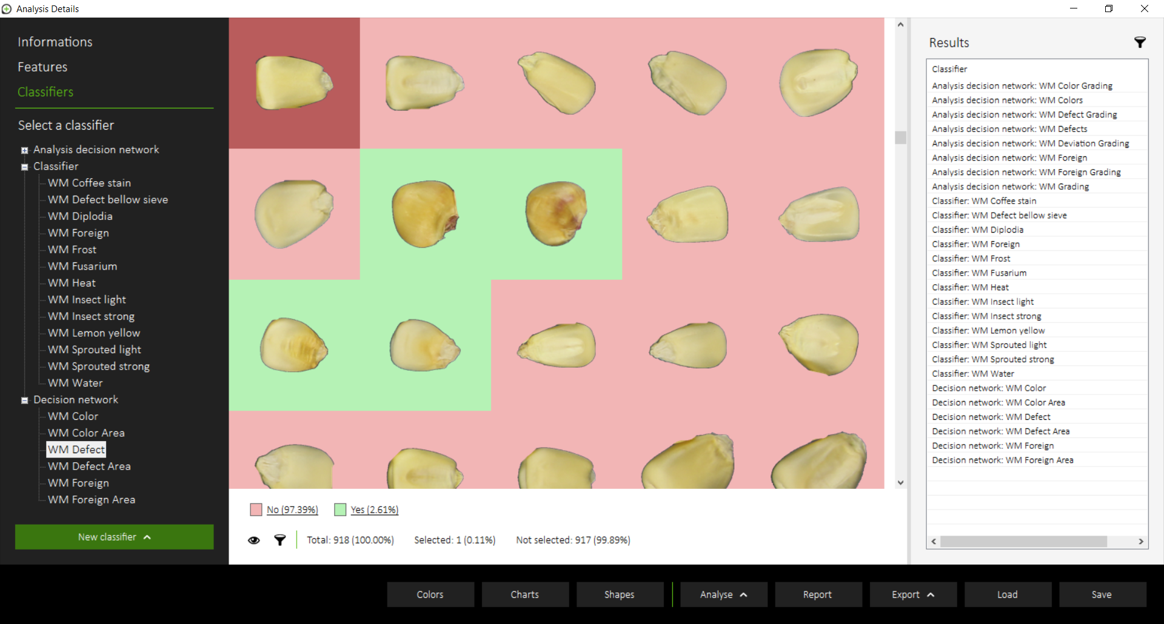
Analysed grains (top and bottom images)

Slide 16
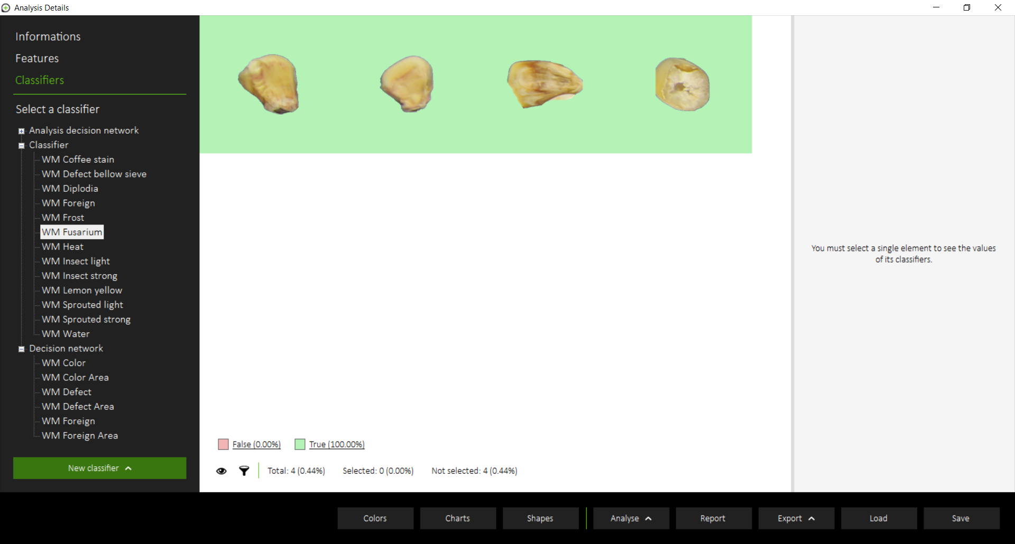
Filtering by defects (sour)

Slide 17
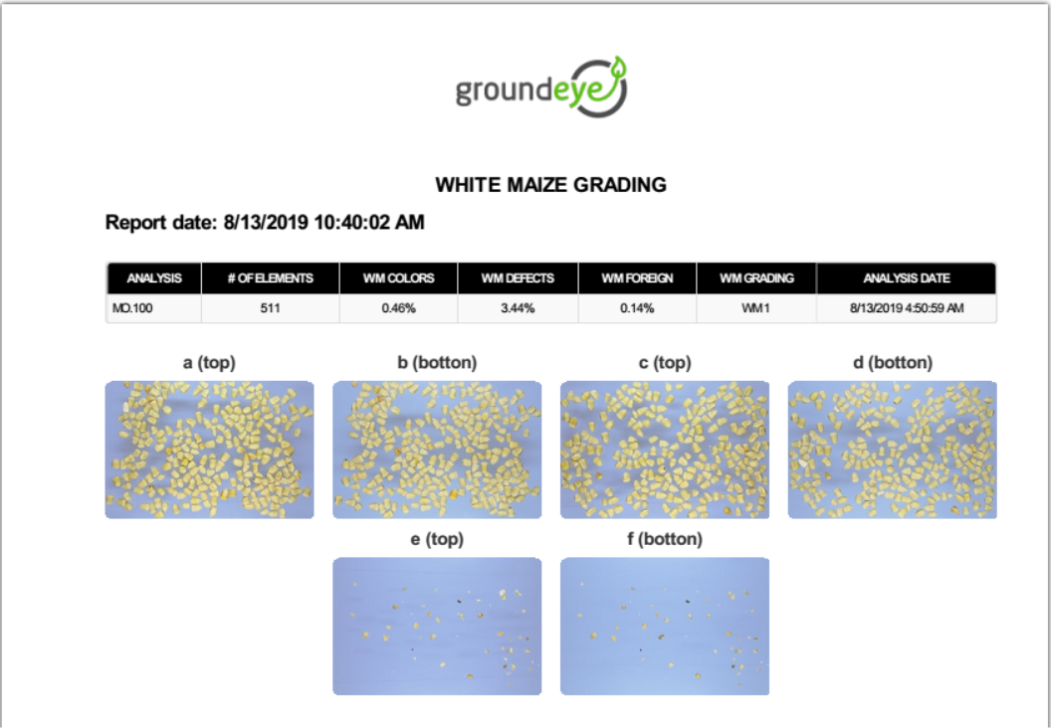
Grading report

Slide 18
Callie Kruger
Agri Manager Southern Africa
Mobile : +27(0)81 457 0680
Bureau Veritas Testing and Inspections Pty Limited SA
495 Summit Road, Summit Office Park
Morningside, Sandton
callie.kruger@bureauveritas.com
www.tbit.com.br
Africa representant

