Slide 1
The Demarcation of Protected Agricultural Areas (PAAs)
A. Collett
DAFF
August 2019

Slide 2
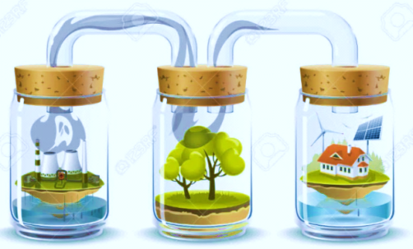
INTRODUCTION
“We must be under no delusion, if we continue to ill-use the soils (“agricultural land with a productive potential”), the land will die and the people will die with it” (Matthews, 1956).
The natural environment is a complex dynamic of interactive linkages between the biotic (living) and abiotic (non-living) components.
All components of the larger landscape are interlinked and the functionality of these components is dependent on each other for it to be effective and able to function optimally.
The environment is further used for many purposes (production of food, water resources for drinking and recreation, mineral resources for mining or residential / industrial developments).
Possible land use conflict
Over-utilisation and degradation, not well managed.

Slide 3
INTRODUCTION
Any activity it will ultimately, either directly or indirectly, have an impact on the natural environment, whether positive or negative.
The impact on the use of the natural resource:
Depend on the use itself
Related activities
Not only limited to the footprint of the activity itself, but also on the larger landscape.
The cumulative impact of many similar (or conflicting) decisions within the same spatial environmental context can be catastrophic.

Slide 4
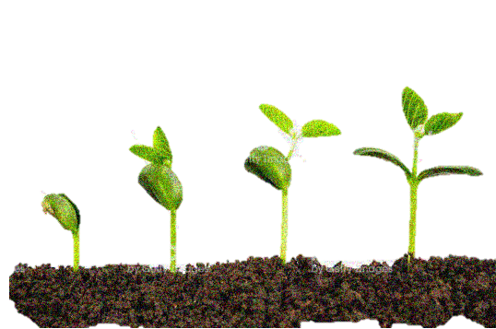
AGRICULTURAL PRODUCTION POTENTIAL
South Africa is a country with limited resource potential for agricultural production, due to its arid nature.
Any negative impact on the production potential of the resource base may have a significant impact on the country’s ability to produce food.
The pressures on the natural agricultural resource base has increased significantly due to an increase in population growth, requiring additional food resources to adhere to the demand – but still to be produced on the existing resources available.
The intensification of the use of the soils as growth medium.
Require an integrative and comprehensive approach in order to rationalize the appropriateness of land use activities and to promote sustainable development (synergy, sustainability, sensible, strategic and supportive) thus ensuring optimal utilization of the natural resources with no degradation.

Slide 5
PURPOSE OF THE PAAs
Legislative requirements:
Subdivision of Agricultural Land Act, 70 of 1970
Draft Preservation and Development of Agricultural Land Bill – PDALB
Indirectly: Spatial Planning and Land Use Management Act, 16 of 2013
PDALB: Agricultural Areas:
“cartographic delineated areas with shared agricultural characteristics, based on the
(a) agricultural potential;
(b) agricultural capability;
(c) agricultural suitability
(d) conservation status;
(e) use; and
(f) geographic location.”
PDALB: Protected Agricultural Areas (PAAs):
“cartographic delineated area of agricultural land –
(a) preserved for purposes of ensuring high value agricultural land is protected against non- agricultural land uses in order to promote long-term agricultural production and food security;
(b) includes all areas demarcated as such;

Slide 6
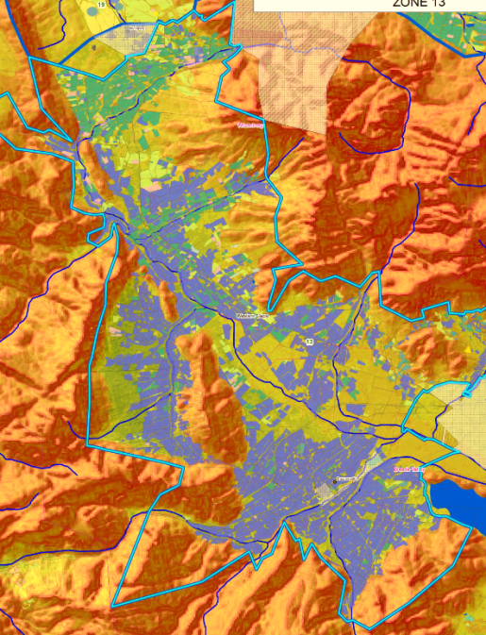
PURPOSE OF THE PAAs
PAAs is regarded as strategic priority agricultural areas, identified on a 1:50 000 scale, which contains significant clusters of high potential agricultural land
Agricultural land uses are recognised as the priority land use (high value / intensive)
Capability, suitability & potential for agricultural production
Proven highly productive agricultural areas / possible “new” expansion areas
Significant agricultural infrastructure investment
Other non-agricultural land uses may however also occur within the PAA

Slide 7
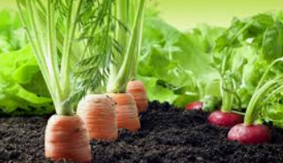
PURPOSE OF THE PAAs
Ensure national food security
Agricultural land with a production potential is a valuable, non-renewable resource – not to be restrained by non-agricultural land uses
Maximize agricultural productivity
Minimise land alienation, conflicting land uses
Minimize negative impact on the environment
Optimal land use efficiency
Economic growth
Important local agricultural industry contributor
Production - Processing - Supply (accessibility / availability)
Job creation / Income generation / Agricultural Infrastructure
Natural resources management
Agro-ecosystem principles Holistic (spatial) Planning!

Slide 8
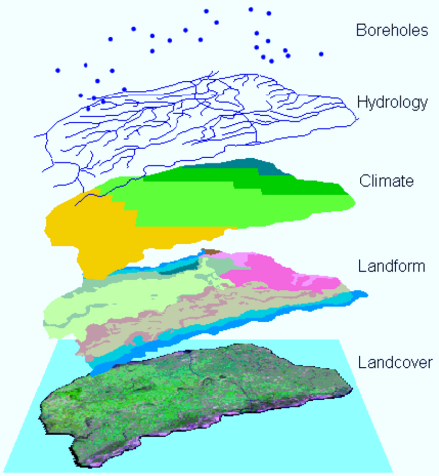
TERMINOLOGY
Agricultural potential”
(a) is a measure of potential productivity per unit area and unit time achieved with specified management inputs; and
(b) for a given crop or veld type and level of management, is largely determined by the interaction of climate, soil and terrain;

Slide 9
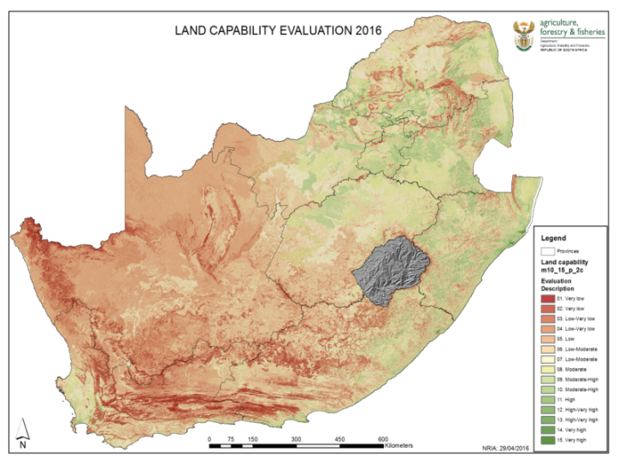
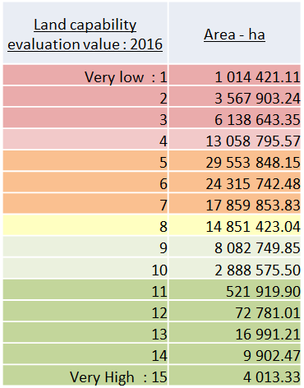
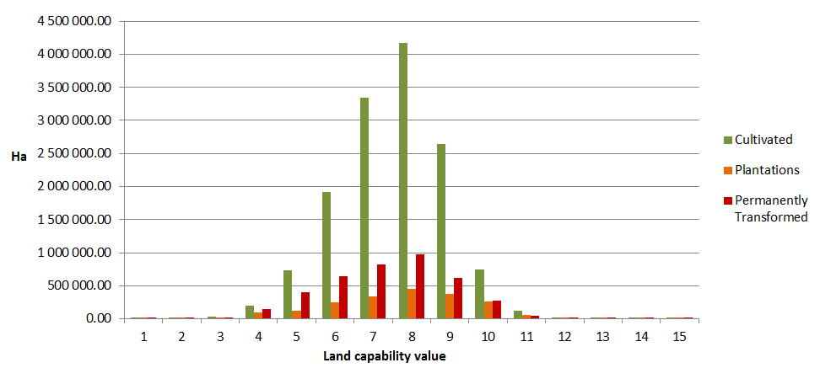
METHODOLOGY
Interactive spatial evaluation factors:
Land capability
Land capability evaluation classes 11 – 15
Land capability evaluation classes 9 – 10
Land capability evaluation classes 8< (rainfed or irrigation)

Slide 10
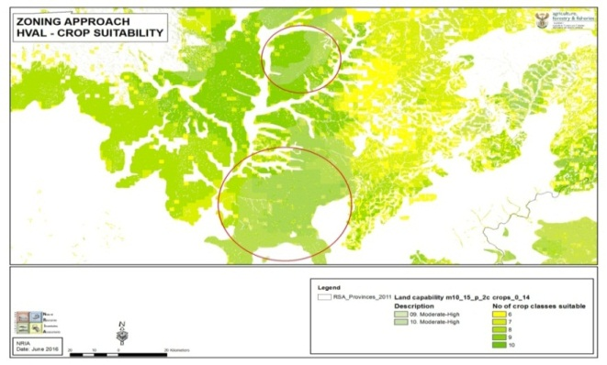
METHODOLOGY
Interactive spatial evaluation factors:
Crop suitability
An area that is suitable for the planting of 10 different crop types, based on its soil, climate and terrain parameters in relation to a crop’s environmental parameters is regarded as of higher importance in comparison with an area that has the suitability for only 2 types of crops.
12 Crop types
>6
Grain crops (Maize; Sorghum; Wheat; Barley; Oats)
Beverage crops (Coffee; Rooibos; Honeybush)
Oil seed crops (Soya beans; Canola; Ground nuts; Sunflower)
Sugar crops (Sugar beet; Sugar cane)
Forage and planted pastures (Kikuyu; Lucerne; Ryegrass; E. curvula (Oulandsgras)
Tropical and Subtropical Fruits (Pineapples; Mango; Avocado; Banana; Litchi; Olives)
Citrus Fruits (generic)
Stone and Pome fruits (Peaches; Apples; Plums)
Nuts (Macadamia; Pecan nuts)
Viticulture (Grapes)
Melons (Water melon)
Vegetables (Potatoes; Tomatoes; Cabbage; Carrots; Drybeans; Pumpkins; Sweet potato)

Slide 11
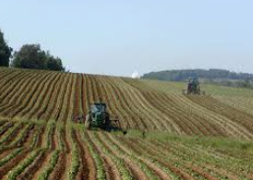
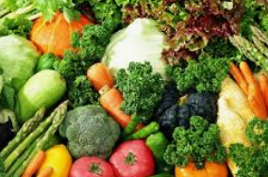
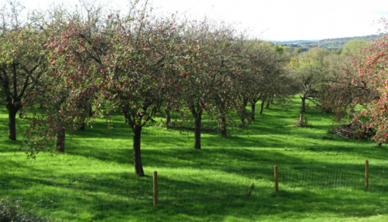
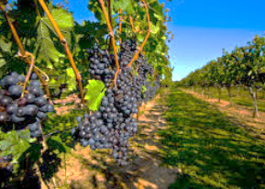
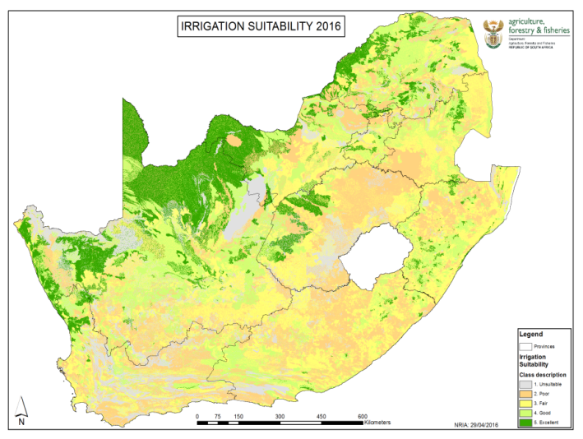
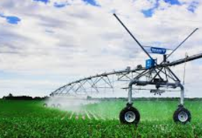
METHODOLOGY
Interactive spatial evaluation factors:
Land use / cover
Cultivated fields
Crop types
Yields
Plantations
Irrigated Areas
Irrigation suitability

Slide 12
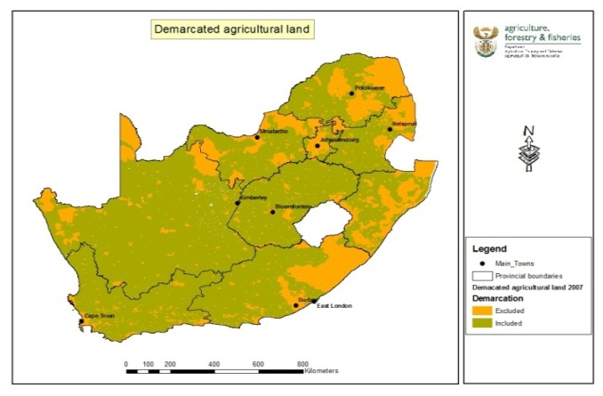
METHODOLOGY
Excluded Areas
Permanently transformed (Landcover 2013/14 & 2017/18)
Built up (residential; industrial; commercial)
Mining
Waterbodies
Municipal areas prior 1994 (2009 >)
Areas not regarded as agricultural land under Sub-division of Agricultural Land Act, 70 of 1970 / PDALB
Formally proclaimed Protected Areas
Areas not available for agricultural production in any format

Slide 13
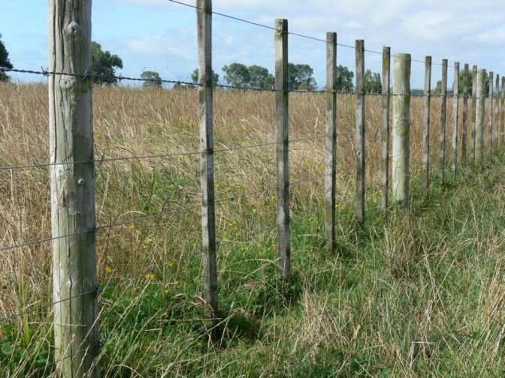
METHODOLOGY
Boundary Alignments
Cadastre (parent farms / portions)
Rivers
Roads
Any other visible permanent feature
(Catchment boundaries)
Adjacent land uses
Areas (size)
Not currently specified
Agro-ecosystem (holistic approach)
Dominant: Homogeneous capability / suitability / potential / land use
Larger “non-fragmented” primary agricultural land use
Acknowledged non – agricultural land uses within
Cohesion: Agro-Biodiversity
Fine scale planning on local level

Slide 14
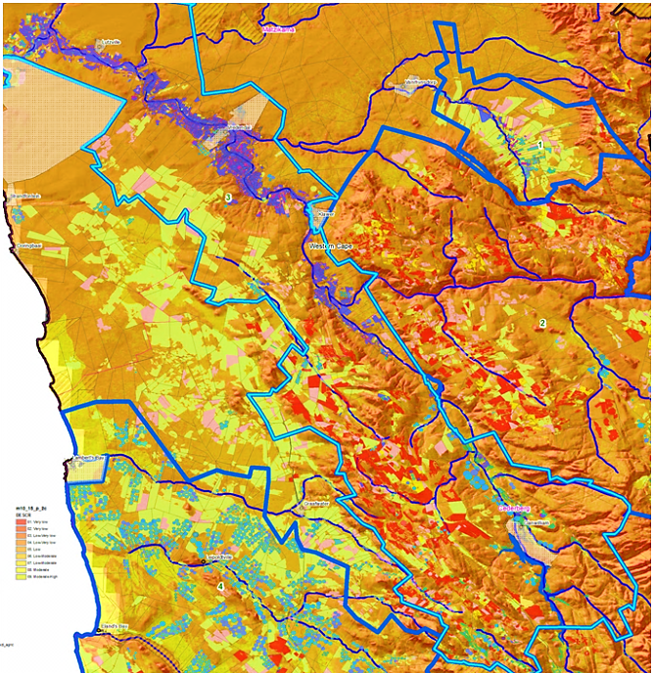
PAA CLASSIFICATION
Classification approach
Rainfed areas
Classification priority rating: A - F
Irrigated areas
Classification priority rating: A - D
Preliminary results (not finalised)

Slide 15
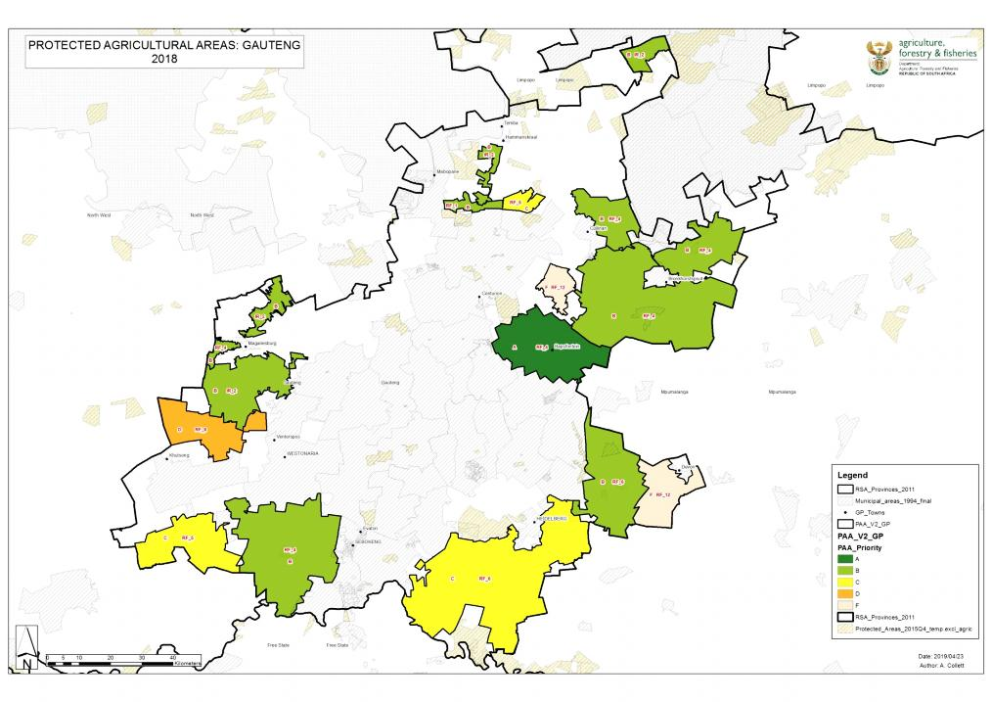
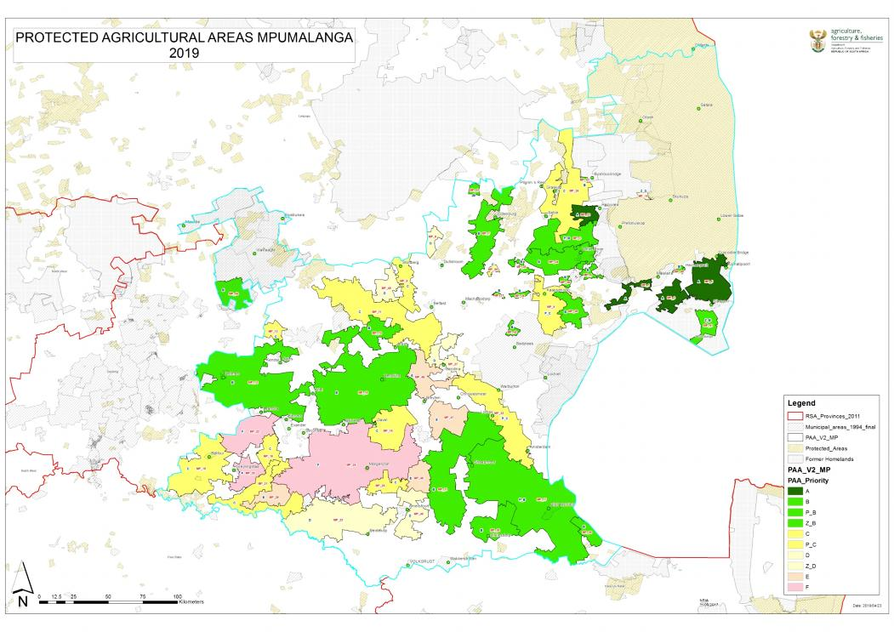
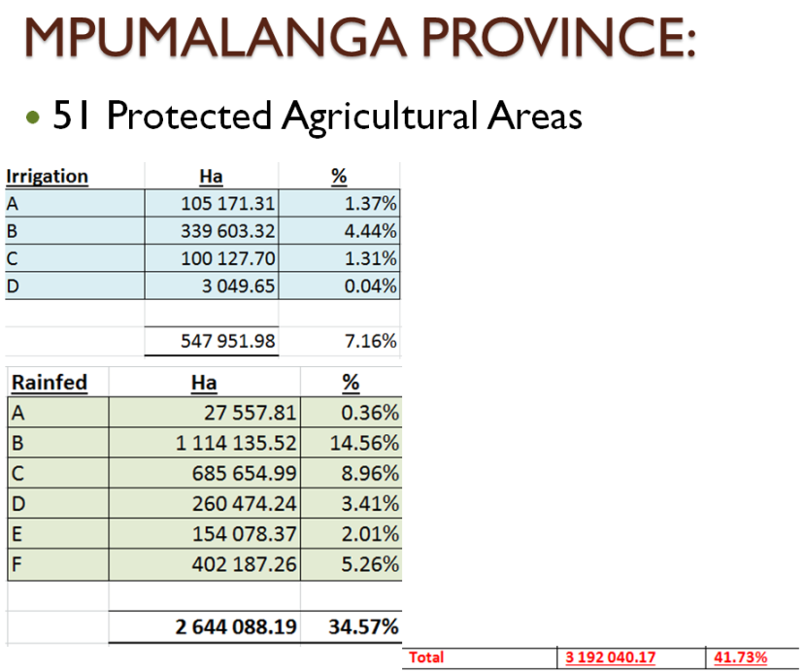

Slide 16
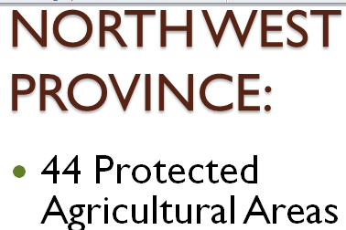
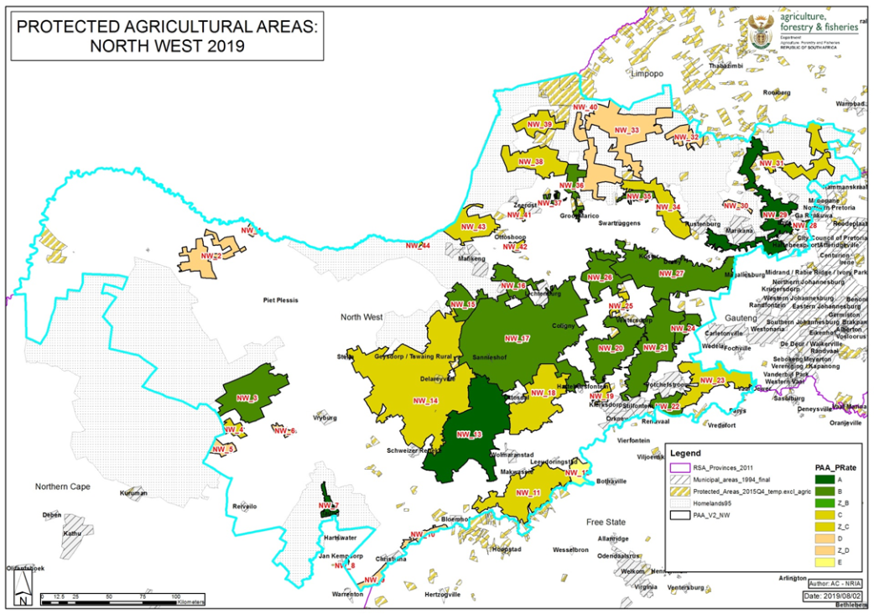
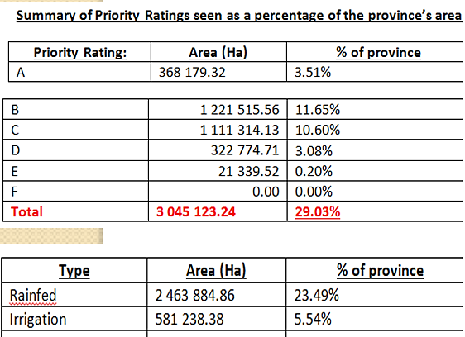
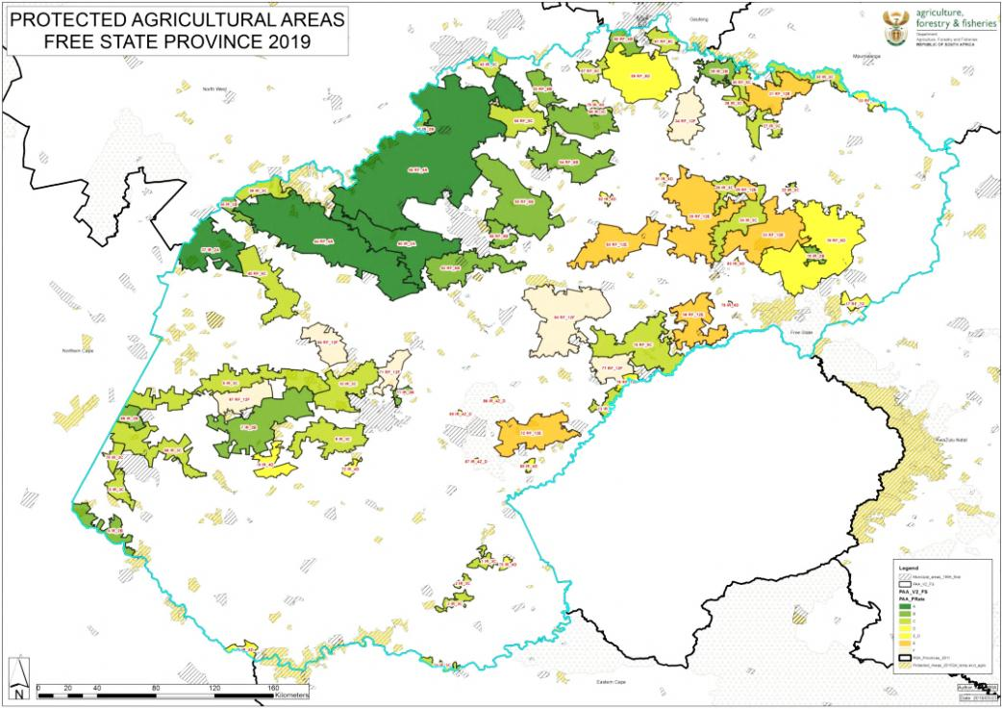
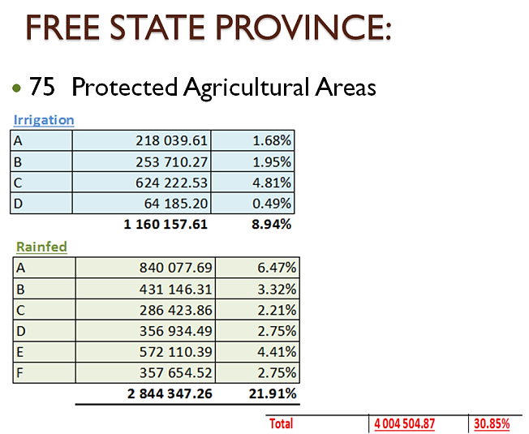

Slide 17
IN CONCLUSION…
A PAAs is dynamic. Many activities occur in a landscape that impacts on the natural resource base, the potential use thereof, the economic viability and the expectations that society has from the landscape.
A PAA may evolve over time as a result of the interactions occurring within the areas and the expansion:
New technologies
Limited impact on the production potential
Co-existence
Adjacent land non-agricultural land uses
Management of a PAA is a multi-disciplinary, integrated process.
Regulations to be developed.
Legal proceedings as per PDALB – still to be followed.

